Slide 1
Tuesday Tutorial
Fanglei Lin, Vasily Morosov, Boaz Nash

Slide 2
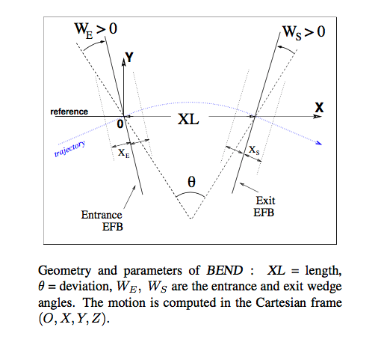
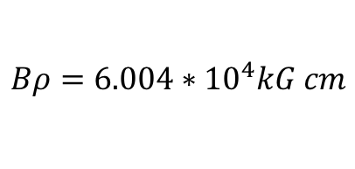
Exercise 1: Statistics of Synchrotron radiation
Emit photons
e- enters
e- leaves
rho = 24.9 m
Electrons pass through single
dipole
B = 2.406 T
XL = 2.4449 m
Input electron energy: 18 GeV
$$Bρ=6.004∗{10}^{4}kG cm$$

Slide 3
Monte Carlo photon emission
Probability of emission of k photons
Critical energy
Average energy loss per particle
Average Energy of photon
radiation
Average number of
Radiated photons per particle

Slide 4
Code diagram
Zgoubi.f
SRLOSS
quasex
CHXC
PRSR
MULTPO
BENDI
INITRA
TRANSF
MAJTRA
Synpar
lpsfit
INTEGR
event
DEVTRA
raysyn

Slide 5
Zgoubi input file
!Compute Synchrotron radiation in a bend
'MCOBJET' 1
60.041537111472856d3
3
5
2 2 2 2 2 2
0. 0. 1.0e-6 0. 0. 1. !0. 0. 0. 0. 0. 1.
0. 26.608754 0. 2
0. 11.302651 0.e-9 2
0. 1. 1e-4 2
123456 234567 345678
'PARTICUL' 2
0.511 1.602176487D-19 0. 0. 0.
'SRLOSS' 3
1
BEND
1 123456
'BEND' 4
0
2.449016210216713777e2 00. 0.4007133486721675049
0.00 000.00 0.04908738521234051935
4 .2401 1.8639 -.5572 .3904 0. 0. 0.
0.00 000.00 0.04908738521234051935
4 .2401 1.8639 -.5572 .3904 0. 0. 0.
1. cm
3 0. 0. 0.
'END' 5
KEYWORDS
MCOBJET: initial conditions of particles
PARTICUL: particle definition
SRLOSS: turn on/off synchrotron radiation
BEND: define dipole magnet
FAISTORE: print particle coordinates (.fai)
REBELOTE: track through lattice again
END: done!

Slide 6
SRLOSS keyword. (p. 287 in manual)
Example
'SRLOSS'
1.1
BEND
1 123456
Turn on SR
Set to 1.1 to allow print out to zgoubi.SRLOSS.Out
SR in dipole
Option
(1: dp only)
Random seed for monte carlo
Emission algorithm

Slide 7
Exercise 1 overview
Exercise 1a
Understand .res file and confirm calculations
Exercise 1b
Examine SRLOSS file and plot results in different columns

Slide 8
Exercise 1a
Look at DipoleSR.dat.
It contains the definition of 18 GeV electrons passing through a dipole.
The number of particles may be set in MCOBJET
Number of turns tracked may be set in REBELOTE
You may change the step size also, in the BEND element
Please look in the manual at each of these keywords to understand where to make these changes
Run the DipoleSR.dat file and examine the resulting zgoubi.res file

Slide 9
Output .res file contains results of Zgoubi calculation
*** Warning : entrance sharp edge entails vertical wedge focusing approximated with first order kick, FINT values entr/exit : 0.000
*** Warning : exit sharp edge entails vertical wedge focusing approximated with first order kick, FINT values entr/exit : 0.000
* Theoretical S.R. parameters in local *dipole* field :
Bending radius (Brho/B) : 24.955495 m, deviation angle : 9.81747704E-02 rad
Average energy loss per particle : Eloss = (2/3).r0.c.gamma^3.B.Ang/1000 5814.3427 keV
(elctrn with bta~1 : 88.463*E[GeV]^4/rho[m]*(Ang/2pi))
Critical photon energy : Ec = 3.gamma^3.c/(2.rho)*(Hbar/e)/1000 = 518.40209 keV
Average photon energy : <Eph> = 8/(15.sqrt(3)) *Ec = 159.62645 keV
rms photon energy : Eph_rms = 0.6383.Ec = 330.89605 keV
Number of average photons per particle inside dipole : N = Eloss/<Eph> = 36.424683
* Theoretical S.R. parameters, summed over magnets up to this point :
Average energy loss : 5814.3427 keV/particle
- relative to initial energy : 3.23019038E-04
Number of average photons : 36.424683 /particle
Field has been * by scaling factor 60.041537
KPOS = 3 : automatic positioning of element,
XCE, YCE, ALE = 0.000000000 0.000000000 -4.9087385212E-02 cm/cm/rad
Integration step : 3.000 cm
A 1 1.0000 0.000 0.000 0.000 0.000 244.902 -0.002 -0.049 0.000 0.000 1
KPOS = 3. Automatic positionning of element.
X = 0.000 CM Y = 0.000 cm, tilt angle = -4.908739E-02 RAD
Cumulative length of optical axis = 2.45000000 m ; Time (for ref. rigidity & particle) = 8.172320E-09 s
Run Zgoubi to produce .res file
Try to verify synchrotron radiation results yourself in the jupyter notebook!
Press + button to insert new cell
(lambda has already been done for you)
Critical energy
Average photon energy
average energy loss per particle
Example Expected Zgoubi.res file:
Length = 2.449016E+02 cm
Arc length = 2.450000E+02 cm
Deviation = 5.625000E+00 deg., 9.817477E-02 rad
GAP = 0.000000E+00 cm
Gradient = 0.000000E+00 kG/cm
Grad-prime = 0.000000E+00 kG/cm^2
Field = 2.4059445E+01 kG (i.e., 4.0071335E-01 * SCAL)
Reference curvature radius (Brho/B) = 2.4955495E+03 cm
Skew angle = 0.000000E+00 rad
Entrance face
DX = 0.000 LAMBDA = 0.000
Wedge angle = 0.049087 RD
Exit face
DX = 0.000 LAMBDA = 0.000
Wedge angle = 0.049087 RD

Slide 10
Exercise 1b
Edit DipoleSR.dat
to change number of particles, (up to ~3000)
and number of turns (up to ~100) and
step size and SRLOSS random seed
Examine zgoubi.SRLOSS.out after each change and running zgoubi.

Slide 11
Using the zgoubi.SRLOSS.out file
40 columns, note that python indexes from 0, so 0…39
Python read command with some useful columns:
turn,emit,xpm,dE,sigE,theo_dEav,Eav_phot,Erms_phot=np.loadtxt('%s/%s'%(FL,'zgoubi_3000p_s123456_ss1cm.SRLOSS.Out'),skiprows=5,usecols=(4,27,31,35,36,37,38,39),unpack=True)
Turn: turn number. (col. 4)
Emit: longitudinal emittance (KeV-cm). (double check…). (col. 27)
xpm: total momentum (KeV). (col. 31)
dE: energy loss per particle (MeV). (col. 35)
sigE: relative energy spread (check this). (col 36)
Theo_dEav: theretical energy loss per particle. (col. 37)
Eav_phot: average energy of a radiated photon. (col 38)
Erms_phot: RMS photon energy. (col 39)
See Exercise 1 Jupyter file for further plotting tools

Slide 12
Exercise 2 overview
Exercise 2a
Calculate the linear parameters in the ESRF lattice and also how to plot twiss functions around the ring
Exercise 2b
Understand how to include twiss zgoubi file into another zougbi file to use for tracking. Examine CAVITE settings and track several sets of initial conditions and observe evolution to equilibrium

Slide 13
Exercise 2a:
We work with the file ESRF_18GeV_Twiss.inc. It is set up to calculate twiss parameters.
'OBJET' 1
60.041537111472856d3
5
.001 .01 .001 .01 .0 .0001
.0 .0 .0 .0 .0 1.
'SRLOSS' 6
0
BEND
1 123456
'PARTICUL' 5
0.511 1.602176487D-19 0. 0. 0.
An electron

Slide 14
We continue with the file ESRF_18GeV_Twiss.inc.
'MARKER' ringstart (MARKER is used to allow this lattice file to be included into a file for tracking)
'MARKER’ ringend
!'CAVITE' (Note that the ‘CAVITE’ must be commented out for twiss calculation)
! 2 .1 .1 is to fill zgoubi.cavite for plot using zpop/7/20
! 812.80224 300 orbit length, h
! 0.7443266709d9 2.617993877991494365 volts, phi_s rad
'TWISS'
2 1. 1. PRINT
Run ZGOUBI to obtain the twiss functions around the ring:
zgoubi –in ESRF_18GeV_Twiss.inc
This should produce the file zgoubi.TWISS.out . Use Exercise 2a notebook to plot the results. Global lattice parameters, such as tunes and chromaticities, are also available in zgoubi.res file.

Slide 15
Exercise 2b:
We work with the file ESRF_18GeV.dat. This file gets all the lattice elements from another file named ESRF_18GeV_Twiss.inc using ”INCLUDE” keyword.
Scaling multiplies field values by constant. These are set for 18 GeV, but could be changed if different energy is required. We do not accelerate here so the initial and final values are the same.
'SCALING'
1 3
QUADRUPO
2
60.041537111472856 60.041537111472856
1 999999
BEND
2
60.041537111472856 60.041537111472856
1 999999
SEXTUPOL
2
60.041537111472856 60.041537111472856
1 999999
'FAISCEAU'
'FAISTORE'
zgoubi.fai
1
'MCOBJET'
60.041537111472856d3
3
100
2 2 2 2 2 2
0. 0. 0. 0. 0. 1.
0. 26.608754 0. 2
0. 11.302651 0.e-9 2
0. 1. 1e-4 2
123456 234567 345678
Use phase space ellipse
# of particles
Hor. Ver. And long. Twiss parameters (alpha, beta and epsilon) for generating Gaussian distribution
Random seeds to generate distributions

Slide 16
'PARTICUL'
0.511 1.602176487D-19 0. 0. 0.
'SRLOSS'
1
BEND
1 123456
'OPTIONS'
1 1
WRITE ON
Synchrotron radiation is on
Include the lattice elements from the twiss file
'INCLUDE'
1
ESRF_18GeV_Twiss.inc[ringstart:ringend]
'CAVITE'
2
812.80224 300 orbit length, h
0.7443266709d9 2.617993877991494365 volts, phi_s rad
Note that we did not include ‘CAVITE’ in the twiss file. It is included here to compensate the synchrotron radiation and provide longitudinal focusing.
'OPTIONS'
1 1
WRITE ON
'REBELOTE'
200 0.1 99
'FAISCEAU'
'END'
Option2 follows dE=qVsin(phi_s)
Track 200 turns

Slide 17
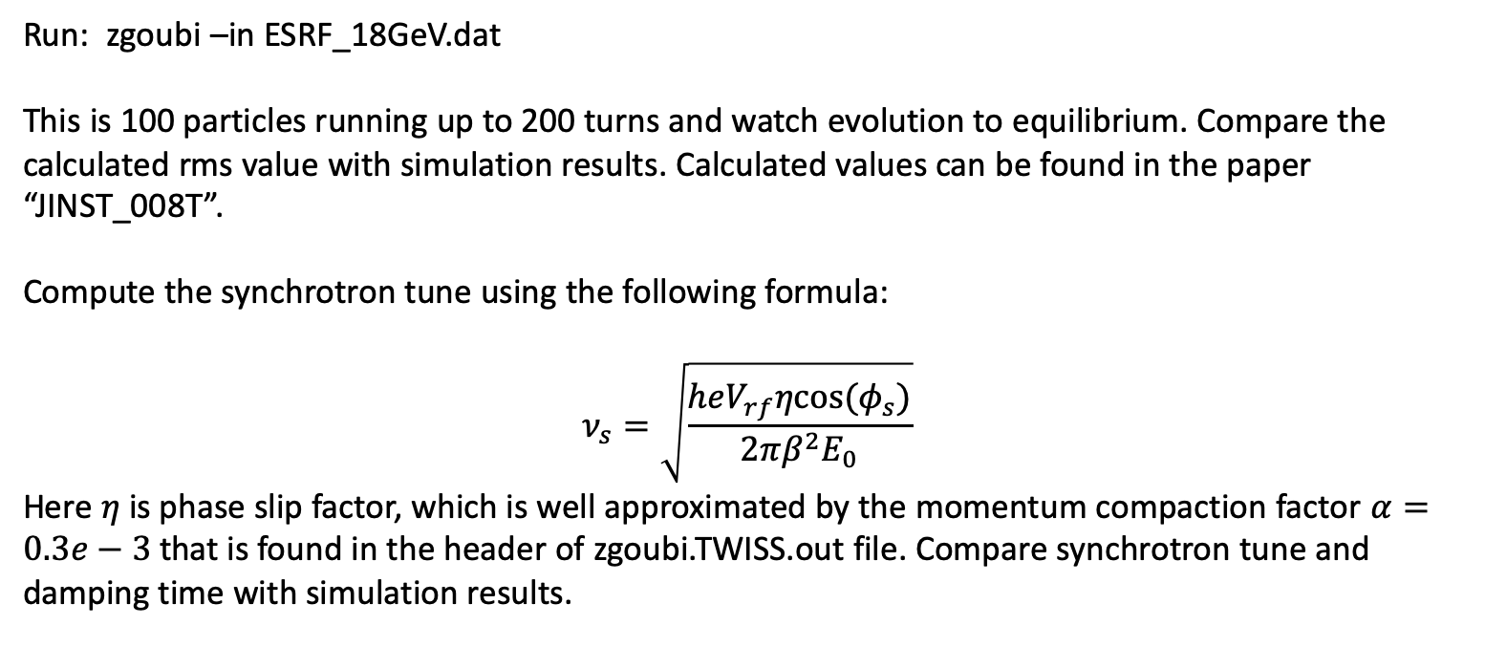
Exercise 2b (Tracking)
Run: zgoubi –in ESRF_18GeV.dat
This is 100 particles running up to 200 turns and watch evolution to equilibrium. Compare the calculated rms value with simulation results. Calculated values can be found in the paper “JINST_008T”.
Compute the synchrotron tune using the following formula:
$$ν_{s}=\sqrt{\frac{heV_{rf}ηcos⁡(φ_{s})}{2πβ^{2}E_{0}}}$$
Here $η$ is phase slip factor, which is well approximated by the momentum compaction factor $α=0.3e−3$ that is found in the header of zgoubi.TWISS.out file. Compare synchrotron tune and damping time with simulation results.

Slide 18
Exercise 3 overview
Exercise 3a
Calculate the linear parameters in the JLEIC electron collider ring lattice and plot twiss functions around the ring. Global parameters also can be found in .res file. Note that SRLOSS and CAVITE are turned off.
Exercise 3b
Watch spin components at the different positions around the ring. Observe how the spin rotates across the spin rotator. Note again SRLOSS and CAVITE are off. Introduce vertical misalignments of quadrupoles, using FIT routine to find invariant spin field on the closed orbit.
Exercise 3c
Turn on SRLOSS and include CAVITE, adjusting spin tune using zero length spin rotator “SPINR” to be away from the zero integer resonance by 0.01. Perform one particle spin tracking with initial spin conditions aligned along the invariant spin field direction. Track for several hundred turns and observe spin dynamics. Now further adjust spin tune to be on the synchrotron tune ~0.027. Track single particle again and observe spin dynamics.

Slide 19
Exercise 3a:
Run: zgoubi –in jleic_bare_twiss.inc
Use Exercise 3a jupyter notebook to obtain lattice functions and global parameters, such as tunes and chromaticities, in zgoubi.TWISS.Out.

Slide 20
Geometry and Twiss functions from Sirepo
https://beta.sirepo.com/zgoubi#/lattice/OdnrhFf1

Slide 21
Exercise 3b:
Run: zgoubi –in jleic_bare_spin_include.dat
(This .dat file includes jleic_bare_twiss.inc, which we just used for twiss calculations, except that we just track one single particle one time around the ring.)
Use Exercise 3b jupyter notebook to observe spin rotation.
Next we use “FIT” to find the invariant spin direction after introducing vertical quadrupole misalignments
'FIT'
3 save spinFITVals.save
4 10 0 [-1.,1.]
4 11 0 [-1.,1.]
4 12 0 [-1.001,1.001]
4 1e-10
10.1 1 1 #End 0 1. 0
10.1 1 2 #End 0 1. 0
10.1 1 3 #End 0 1. 0
10 1 4 #End 1. .2 0
'SPNTRK'
4
0. 0. 1.

Slide 22
Exercise 3b: continued
Run zgoubi –in jleic_vma_FIT.dat
You will get zgoubi.FIT.out.dat, a new copy of the lattice but with the results of invariant spin field set as the initial spin direction
'SPNTRK'
4
-1.15226337E-02 1.80246914E-02 9.99780302E-01

Slide 23
Exercise 3b: continued
Modify zgoubi.FIT.out.dat file to zgoubi.FITout.dat file
'SRLOSS'
1 ! .srloss
BEND
1 123456
'CAVITE'
2
2185.536268 1816
6759397.37376 3.02085955961
'REBELOTE'
10000 0.4 99

Slide 24
Exercise 3c:
Run: zgoubi –in zgoubi.FITout.dat with SPINR (p.284 in the manual) set to two different values
Use Exercise 3c jupyter notebook to observe spin dynamics.
'SPINR' SOLE ST1
1
0 9.72
Spin procession angle around the axis:
9.72 degrees produces spin tune of 0.027
3.64 degrees produces spin tune of 0.01
Angle (in (X,Y) plane) between the X-axis and the spin precession axis

